Slide 1

Concrete Strength Prediction
Capstone Project 4 : Machine Learning using Python

Slide 2
Content Page
Introduction and Objective
Methodology
Process Workflow
Results
Conclusions
Future Opportunities
Appendix

Slide 3

Introduction & Objective

Slide 4
Introduction
Profession:
Engineer
Organization:
Construction firm/Consulting firm
Target Audience: Developers/construction firms
- Engineers
-project managers

Slide 5
Objective
Compressive strength is one of the most important engineering properties of concrete
Time – consuming to get the correct mix for the required compressive strength
Materials, labour and testing costs might increase
Learn about the relations between variables and develop a predictive model
Goal: To predict the strength of concrete

Slide 6


Methodology

Slide 7
Methodology
Dataset (from UCI ML Repository)
Title: Concrete Compressive Strength Data Set
Source: https://archive.ics.uci.edu/ml/datasets/Concrete+Compressive+Strength
Models used:
Random Forest Regressor
Linear Regressor
Ridge Regressor
Lasso Regressor
Support Vector Regressor
KNN Regressor
Metric: Regression problem
MSE
Tools:
Python
Matplotlib
Seaborn
Pandas
Numpy
Sklearn
Scipy

Slide 8

Process Workflow

Slide 9
Process Workflow
1.Formulate the hypothesis/objective.
2.Use data already used in one of the previous capstone projects. Identify the inputs and output(s) from that data. If not possible, gather new data.
3.Clean & Transform the data as required
4.Perform Feature Engineering
5.Build Machine Learning Models
6.Compare various Machine Learning Models using performance metrics
7.Optimize the model if required
8.Explain the end result. Circle back to the objective.

Slide 10
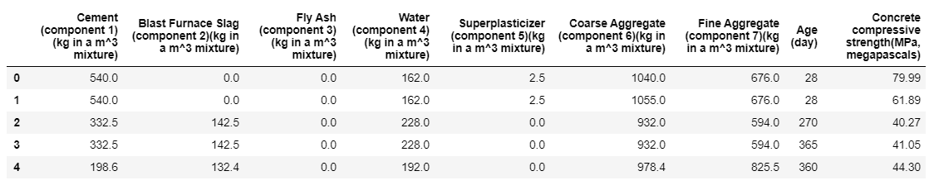
Data
Title : Concrete Compressive Strength Data Set (Research Paper by Prof. I-Cheng Yeh)
File type : CSV
No missing values
Number of instances : 1030
Number of Attributes : 9
Input attributes : 8
Output target : 1

Slide 11
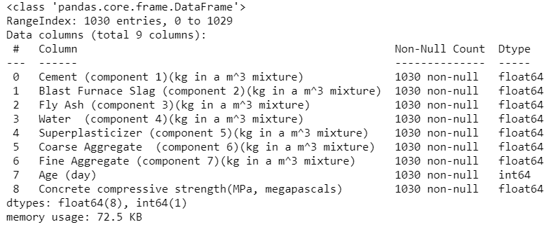
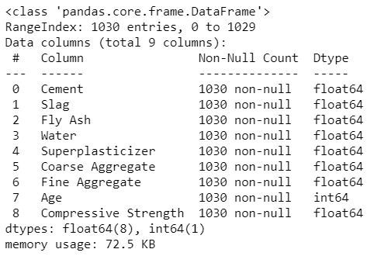
Process Workflow
Data Preparation
Renaming of columns to succinct titles

Slide 12
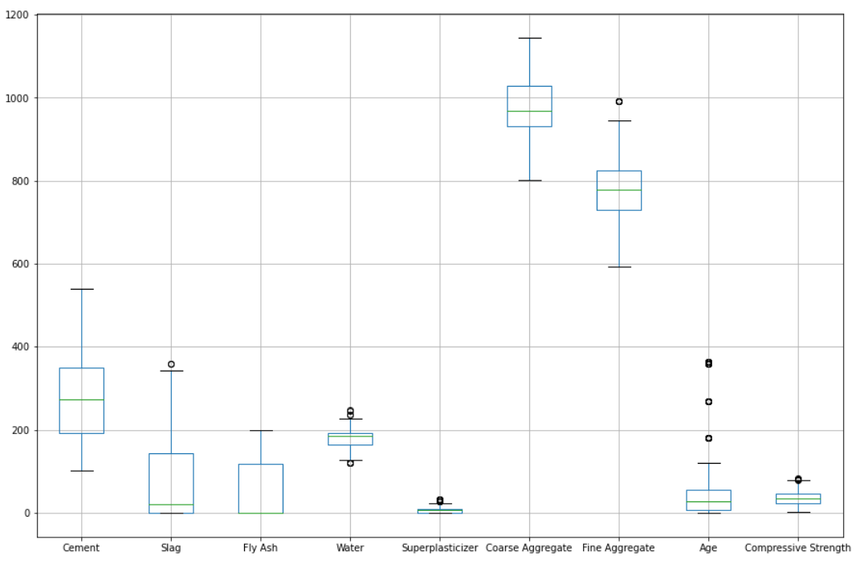
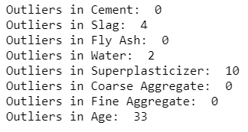
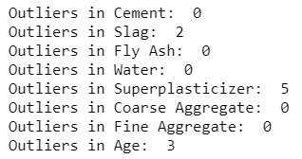
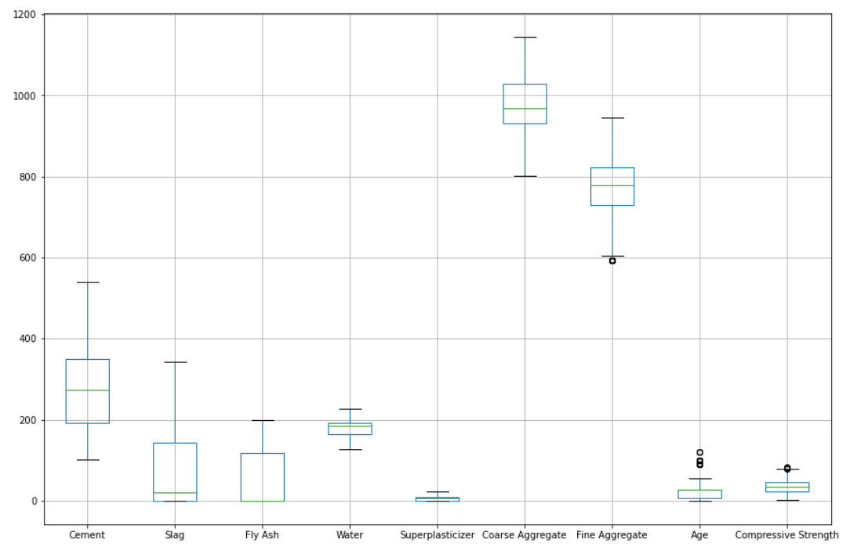
Process Workflow
Data Preparation
2. Replacing outliers with median
#an outlier if it is larger than 3 std deviation

Slide 13
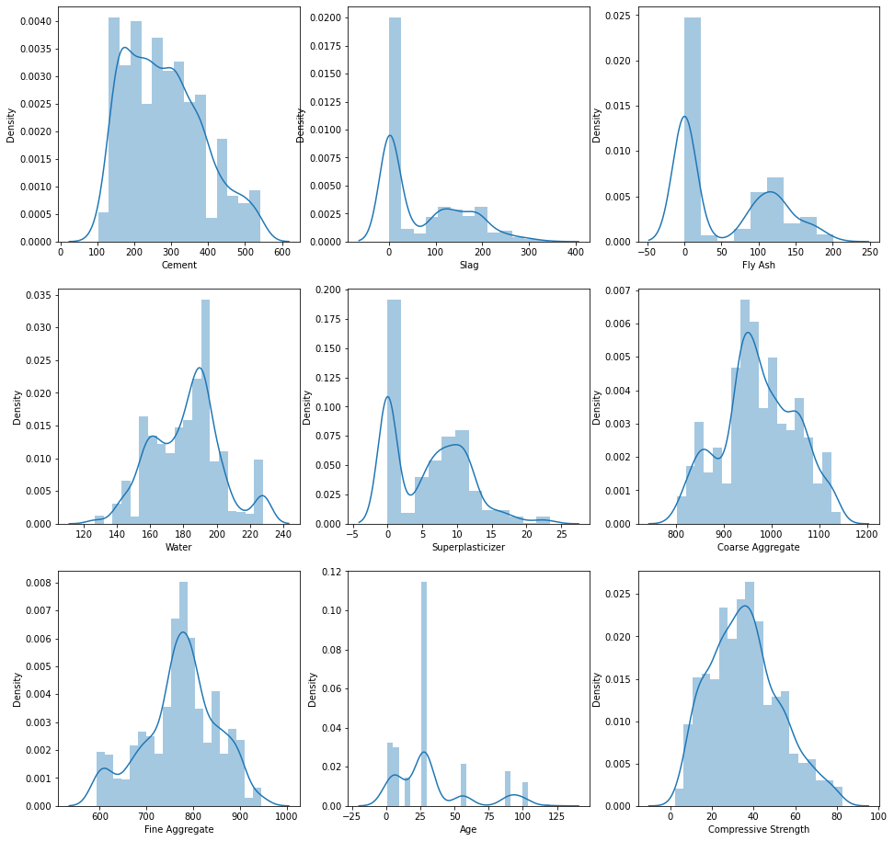
EDA - Distplot
Distribution of the attributes:
Cement is almost normal.
Slag has 3 Gaussians and rightly skewed
Fly Ash has 2 Gaussians and slightly left skewed
Water has 3 Gaussians and slightly left skewed
Superplastic has 2 Gaussians and slightly right skewed
Coarse Aggregate has 3 Gaussians and almost normal
Fine Aggregate has almost 2 Gaussians and looks like normal
Age has multiple Gaussians and rightly skewed
Normalization can be done
Existence of outliers

Slide 14
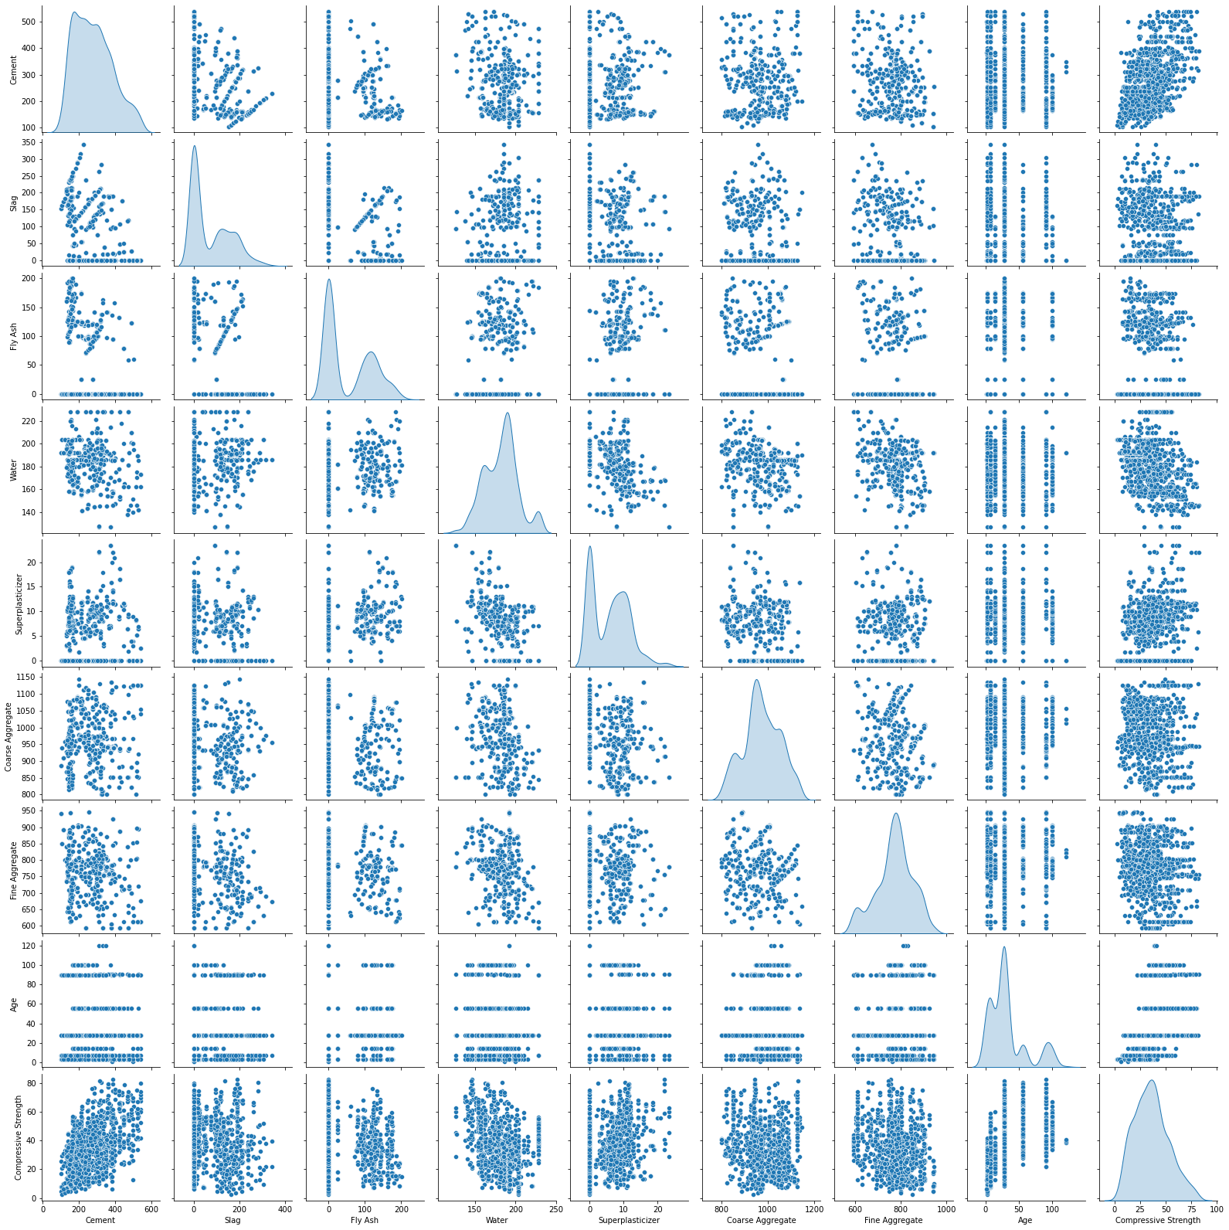
EDA - Pairplot
No strong correlation observed
No multicollinearity present

Slide 15
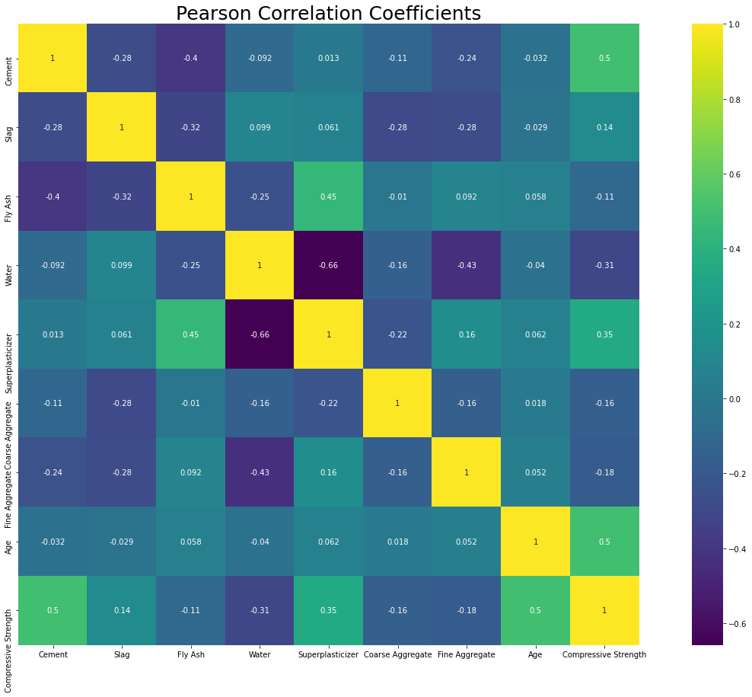
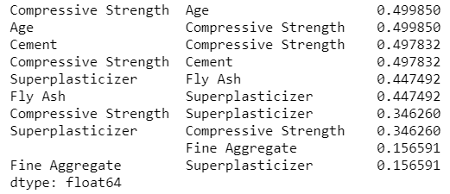
EDA
Top 3 variables correlation with Compressive Strength:
Age
Cement
Superplasticizer

Slide 16
Feature Engineering & Data Transformation
Splitting the data into independent and dependent attributes
Independent features: Cement, Slag, Fly Ash, Water, Superplasticizer, Coarse Aggregate, Fine Aggregate, Age
Drop feature ‘Compressive Strength’
Target: ‘Compressive Strength’
Split data into training and testing datasets
Test size = 0.2
Data normalization
zscore for training and testing datasets
Output
Input

Slide 17


Results

Slide 18
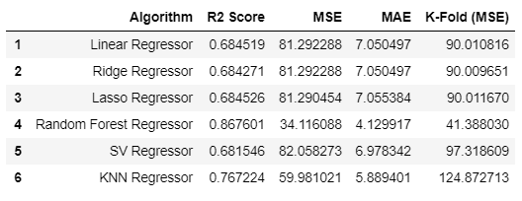
ML Model Performance Results
Best Model: Random Forest Regressor
Lowest MSE → Least Error
Optimized tuning of hyperparameters for Random Forest and KNN regressors were done

Slide 19

Conclusion

Slide 20
Conclusion
Best Model : Random Forest
MSE: 34.116
Ensemble models does better in this problem than linear models due to high number of features
Through EDA, discovered that cement, age and superplasticizer have a positive impact on the overall strength
Through ML model, able to predict the concrete strength with the input values
Which reduce wait/trial and error time and total number of combinations need to be done on site
Highlighting potentially optimal combinations to then be used in physical testing will provide enormous benefit
significantly reduce labour
testing costs

Slide 21
Interesting Insight
Does removing the ‘Water’ attribute from the model reduces the MSE of the Random Forest model?
NO!
Water is also an essential component of concrete making.

Slide 22

Future Opportunities

Slide 23

Future Opportunities
Fine Tuning of hyperparameters for ensemble models
Import more data which includes external factors like temperature and relative humidity for a complete prediction approach

Slide 24

Appendix
The Constructor, Civil Engineering Home. “Factors affecting the strength of concrete”.
https://theconstructor.org/concrete/factors-affecting-strength-of-concrete/6220/

Slide 25

Thank you! Q & A

